Slide 1
Data Structure and Algorithms
Azaz Ahmed Kiani

Slide 2
Stack Applications Lesson 14
2

Slide 3
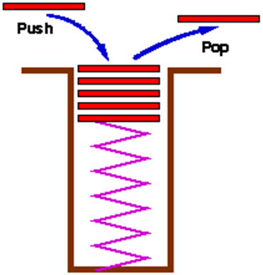
Stack (Recap)
An ordered collection of homogeneous data elements where the insertions and deletions take place at on end only called Top
New elements are added or pushed onto the top of the stack
The first element to be removed or popped is taken from the top - the last one in

Slide 4
Application of Stacks
Balancing of symbols
Infix to postfix conversion
Page-visited history in a Web-browser [Back Buttons]
Undo sequence in a text editor

Slide 5
Balanced Symbol Checking - Stack Application
In processing programs and working with computer languages there are many instances when symbols must be balanced { } , [ ] , ( )
A stack is useful for checking symbol balance
When a closing symbol is found it must match the most recent opening symbol of the same type

Slide 6
Balanced Symbol Checking - Stack Application
Make an empty stack
Read symbols until end of file
if the symbol is an opening symbol push it onto the stack
if it is a closing symbol do the following
if the stack is empty report an error
otherwise pop the stack. If the symbol popped does not match the closing symbol report an error
At the end of the file if the stack is not empty report an error

Slide 7
Parentheses Matching (Concept)
( [ ] { } ) balanced.
( { [ ] } ) balanced.
( { } not balanced.
( } not balanced.

Slide 8
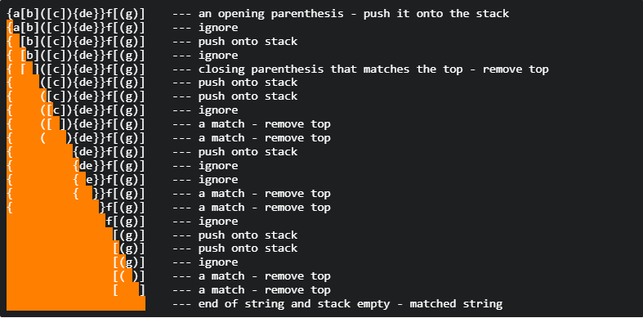
Balanced Symbol Checking (A View)

Slide 9
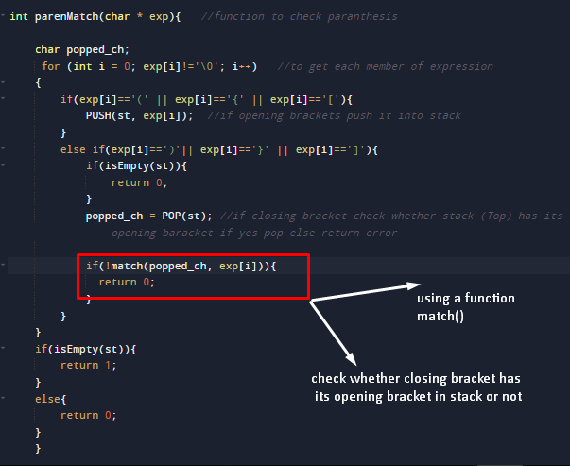
Balanced Symbol Checking (Snippet)

Slide 10
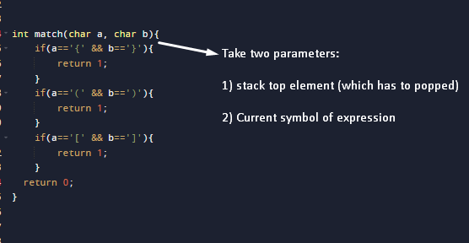
Match() Function

Slide 11
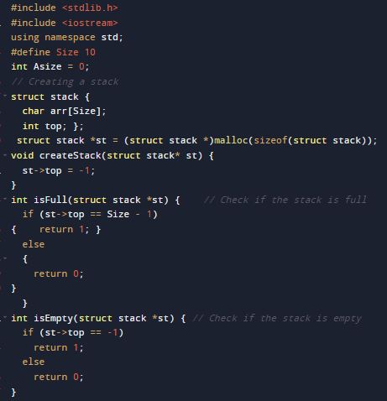
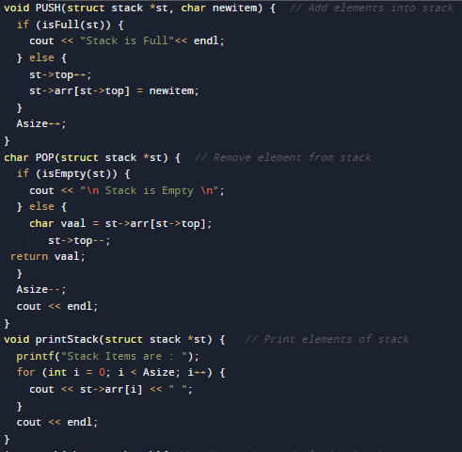
Complete Program

Slide 12
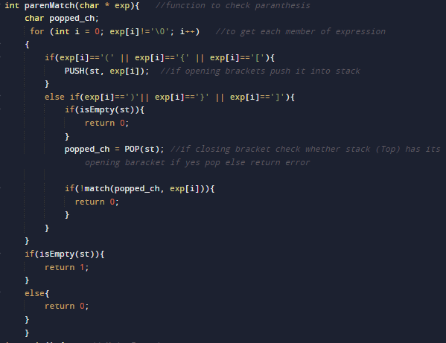
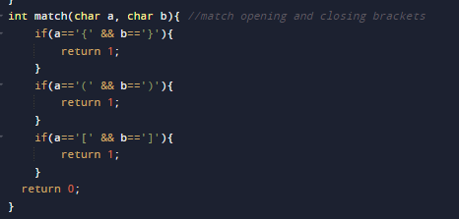
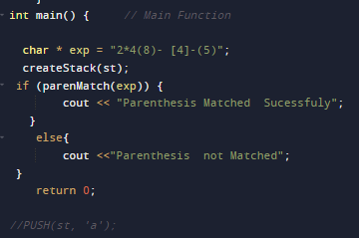
Complete Program

Slide 13
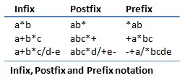
Mathematical Expression Notation
The way we are used to writing expressions is known as infix notation
Postfix expression does not require any precedence rules
3 2 * 1 + is postfix of 3 * 2 + 1

Slide 14
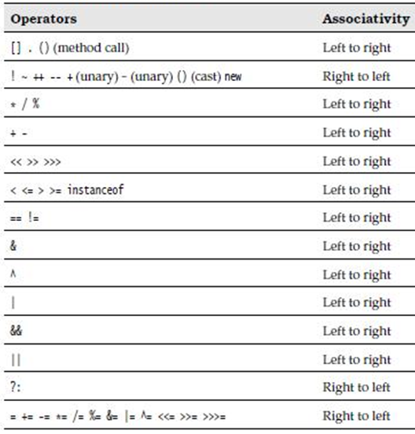
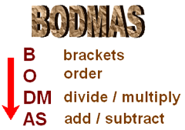
Operator Precedence and Associativity
Order includes Power, square roots

Slide 15
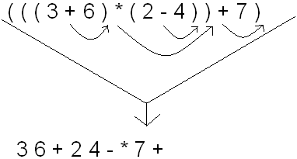
Converting Infix to Postfix Notation
The first thing you need to do is fully parenthesize the expression.
So, the expression (3 + 6) * (2 - 4) + 7
Becomes (((3 + 6) * (2 - 4)) + 7).
Now, move each of the operators immediately to the right of their respective right parentheses. If you do this, you will see that
(((3 + 6) * (2 - 4)) + 7) becomes 3 6 + 2 4 - * 7 +

Slide 16
Converting Infix to Postfix (Steps)
First Start scanning the expression from left to right
If the scanned character is an operand, output it, i.e. print it
Else
If the precedence of the scanned operator is higher than the precedence of the operator in the stack(or stack is empty or has'(‘ ), then push operator in the stack
Else, Pop all the operators, that have greater or equal precedence than the scanned operator. Once you pop them push this scanned operator. (If we see a parenthesis while popping then stop and push scanned operator in the stack)
If the scanned character is an ‘(‘, push it to the stack.
If the scanned character is an ‘)’, pop the stack and output it until a ‘(‘ is encountered, and discard both the parenthesis.
Now, we should repeat steps 2 – 6 until the whole infix i.e. whole characters are scanned.
Print output
Do the pop and output (print) until the stack is not empty

Slide 17
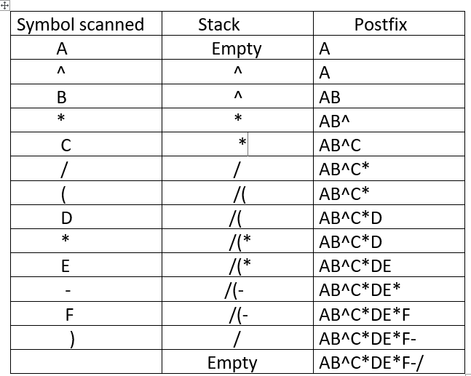
Infix to Postfix (Concept)

Slide 18
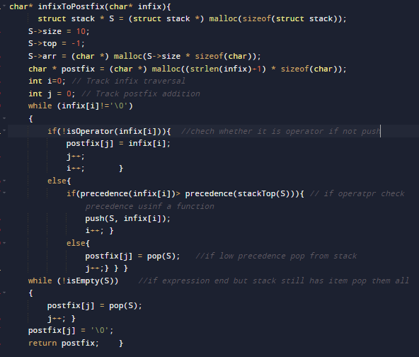
Infix to Postfix (Snippet)

Slide 19
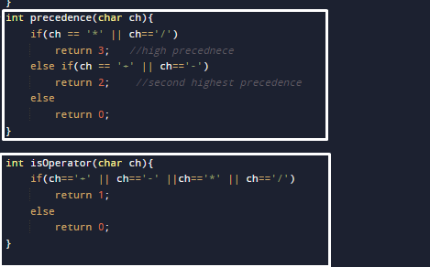
Check Precedence and operator function

Slide 20
Summary...!

